Slide 1

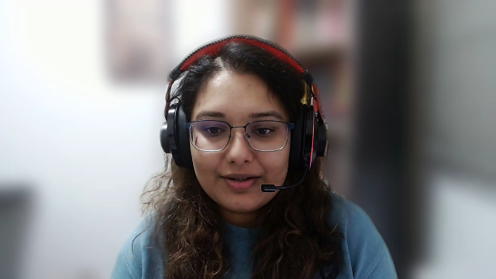
Sentiment Analysis of ChatGPT on YouTube
Key Findings and Insights
Notes:
"Hello everyone! In today's presentation, I'll walk you through the findings from the sentiment analysis I conducted on YouTube comments related to ChatGPT.""Our goal was to understand public perception of ChatGPT and identify actionable insights that can help guide our marketing strategy at FutureProof."

Slide 2
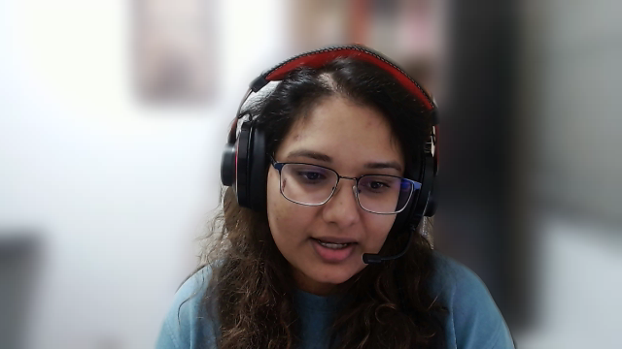
Overview of Sentiment Analysis
Objective:
To perform a comprehensive sentiment analysis of ChatGPT's reception based on YouTube comments, aiming to understand public perception and user sentiment towards the platform.
Scope:
Categorisation
Thematic Breakdown
Sentiment Score Analysis
Notes:
"As a Data Analyst at FutureProof, my objective was to analyze the sentiment expressed in YouTube comments toward ChatGPT."
"I categorized the sentiment into Positive, Neutral, and Negative groups, and also performed a thematic analysis focusing on themes like Usefulness, Ethics, and Accuracy."
"In addition, I analyzed the variability in sentiment scores, which helped us understand how strongly users feel about ChatGPT."

Slide 3
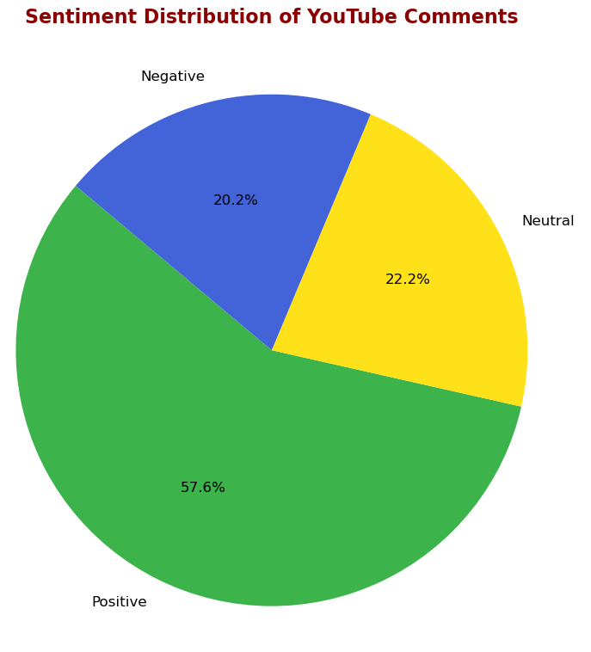
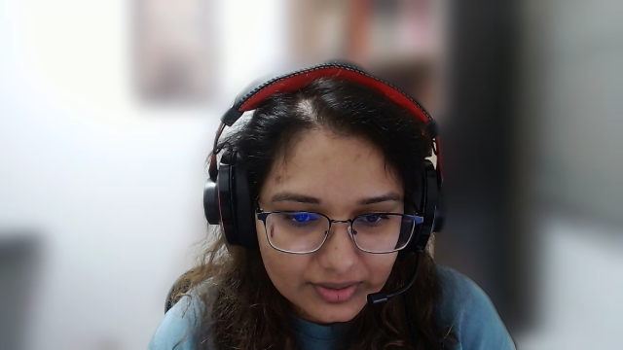
Sentiment Breakdown
57.6% Positive
22.2% Neutral
20.2% Negative
This chart illustrates the general sentiment towards ChatGPT, with most users expressing positive views.
Notes:
"From the sentiment breakdown, we see that 57.6% of comments express a positive sentiment toward ChatGPT, indicating that users find it useful or valuable."
"However, there's still 22.2% neutral sentiment, suggesting that many users haven't formed a strong opinion either way."
"The 20.2% negative sentiment indicates areas where users have concerns, which we need to address to ensure greater user satisfaction."

Slide 4
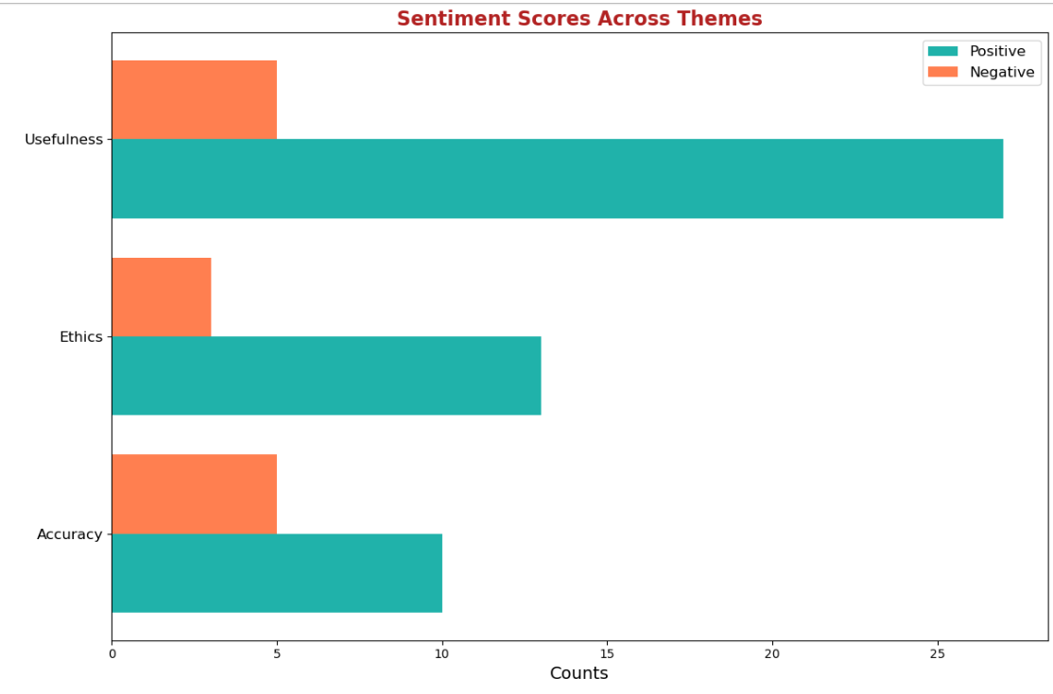
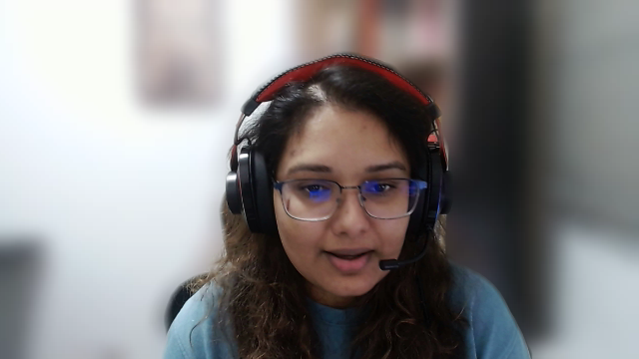
Thematic Analysis
Themes: Usefulness, Ethics, Accuracy.
Positive sentiments dominate, but there are mixed opinions on Ethics and Accuracy.
Focus on addressing concerns around accuracy and bias.
Notes:
"I also dug deeper into specific themes such as Usefulness, Ethics, and Accuracy, which are major factors in how people view ChatGPT.""The Usefulness theme had mostly positive feedback, showing that users appreciate ChatGPT’s practical applications.""On the other hand, themes like Ethics and Accuracy revealed mixed sentiment, with some users raising concerns about AI biases and the tool's reliability.""Addressing these concerns can help improve the overall perception and trust in ChatGPT."

Slide 5
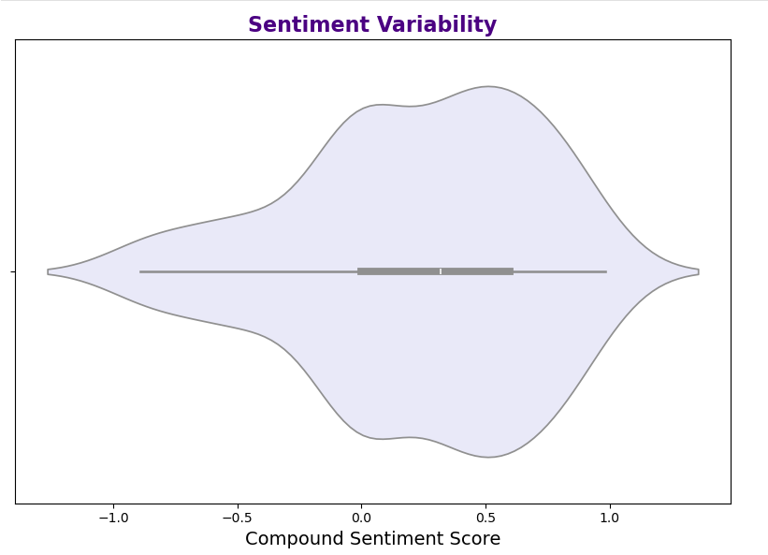
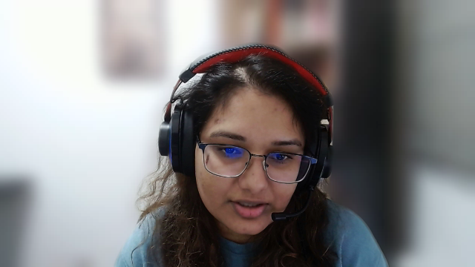
Insights from Density Analysis
The distribution of sentiment scores indicates a positive skew.
Most comments fall between neutral and moderately positive.
The plot provides insights into sentiment variability and clustering.
Notes:
"The density plot reveals that most sentiment scores are clustered between neutral and moderately positive, suggesting a lot of cautious optimism.""While the positive sentiment is strong, a significant portion of users remains unsure. This gives us an opportunity to convert neutral users into advocates by demonstrating ChatGPT’s potential more clearly."

Slide 6
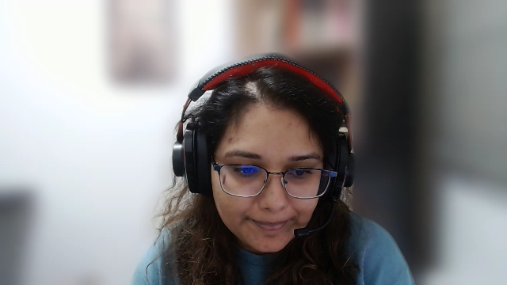
Key Takeaways for Business Users
Promote ChatGPT's positive aspects and the value users recognise.
Address ethical concerns and accuracy issues transparently.
Convert neutral users into advocates by educating and engaging them.
Expand sentiment analysis to other platforms for a comprehensive view.
Continuously refine strategies based on feedback and sentiment trends.
Notes:
"In conclusion, ChatGPT has a predominantly positive perception, but ethical concerns and accuracy issues need to be addressed.""To further drive adoption, we should leverage the positive sentiment by showcasing real-world use cases and success stories.""It's also critical to address the negative sentiments, particularly concerns related to AI bias and inaccuracies, through transparent communication and updates.""I recommend focusing on neutral users, providing them with targeted education and demos to help them see the value ChatGPT offers.""Finally, expanding sentiment analysis to other platforms like Twitter and LinkedIn will give us a broader perspective on how ChatGPT is being perceived across different audiences."

